Slide 1
HTML Colors

Slide 2
HTML Colors
Colors are very important to give a good look and feel to your website.
You can specify colors on page level using <body> tag or you can set colors for individual tags using bgcolor attribute.

Slide 3
HTML Colors
The <body> tag has following attributes which can be used to set different colors:
bgcolor - sets a color for the background of the page.
text - sets a color for the body text.
alink - sets a color for active links or selected links.
link - sets a color for linked text.
vlink - sets a color for visited links - that is, for linked text that you have already clicked on.

Slide 4
HTML Color Coding Methods
There are following three different methods to set colors in your web page:
Color names - You can specify color names directly like green, blue or red.
Hex codes - A six-digit code representing the amount of red, green, and blue that makes up the color.
Color decimal or percentage values - This value is specified using the rgb( ) property.

Slide 5
HTML Colors - Color Names
You can specify direct a color name to set text or background color.
W3C has listed 16 basic color names that will validate with an HTML validator but there are over 200 different color names supported by major browsers.

Slide 6
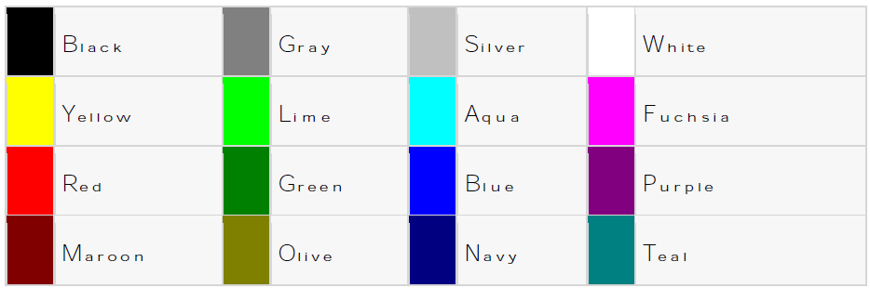
W3C Standard 16 Colors
Here is the list of W3C Standard 16 Colors names and it is recommended to use them.

Slide 7
HTML Colors - Color Names
<html>
<head>
<title>HTML Colors by Name</title>
</head>
<body text="blue" bgcolor="green">
<p>Use different color names for body and table and see the result.</p>
<table bgcolor="black">
<tr>
<td>
<font color="white">This text will appear white on black background.</font>
</td>
</tr>
</table>
</body>
</html>

Slide 8
HTML Colors - Hex Codes
A hexadecimal is a 6 digit representation of a color.
The first two digits (RR) represent a red value, the next two are a green value (GG), and the last are the blue value (BB).

Slide 9
HTML Colors - Hex Codes
A hexadecimal value can be taken from any graphics software like Adobe Photoshop, Paintshop Pro or MS Paint.
Each hexadecimal code will be preceded by a pound or hash sign (#).
Following is a list of few colors using hexadecimal notation.

Slide 10
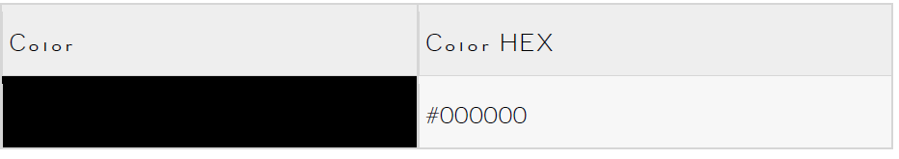
HTML Colors - Hex Codes

Slide 11
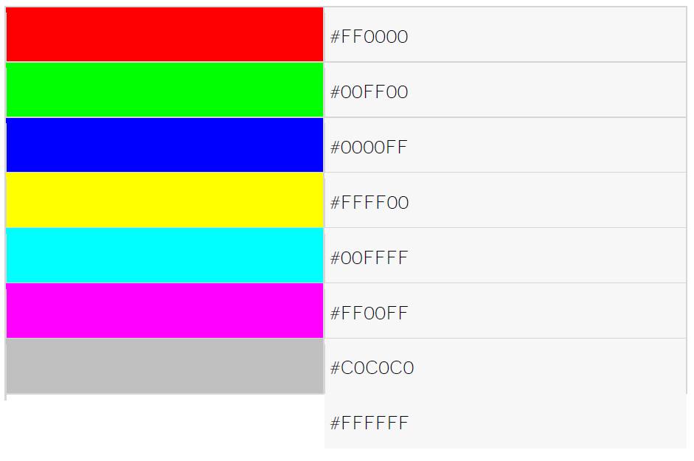
HTML Colors - Hex Codes

Slide 12
HTML Colors – RGB
All the browsers do not support rgb() property of color so it is recommended not to use it.
Following is a list to show few colors using RGB values.

Slide 13
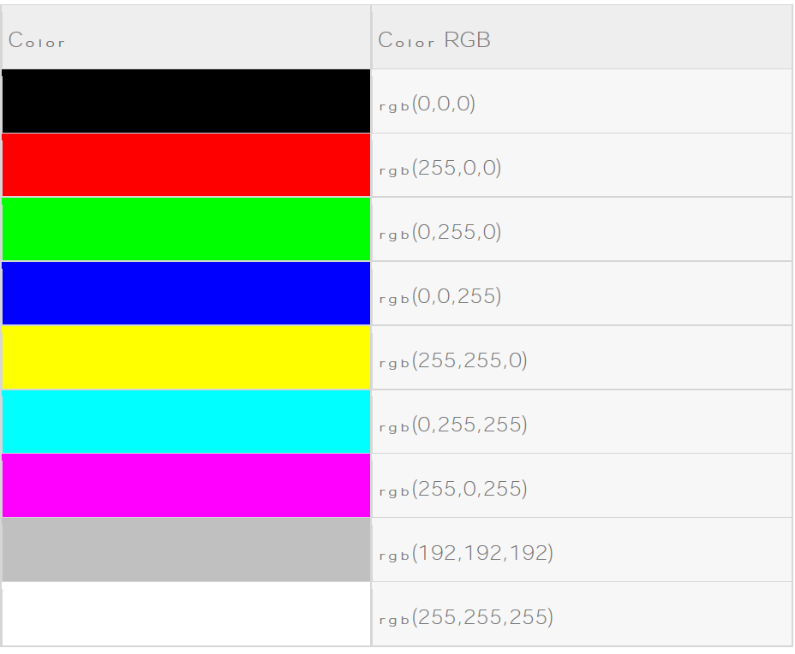

Slide 14
HTML Colors – RGB
Here are the examples to set background of an HTML tag by color code using rgb() values:

Slide 15
HTML Colors – RGB
<html>
<head>
<title>HTML Colors by RGB code</title>
</head>
<body text="rgb(0,0,255)" bgcolor="rgb(0,255,0)">
<p>Use different color code for body and table and see the result.</p>
<table bgcolor="rgb(0,0,0)">
<tr>
<td>
<font color="rgb(255,255,255)">This text will appear white on black background.</font>
</td>
</tr>
</table>
</body>
</html>

Slide 16
HTML Fonts
Fonts play very important role in making a website more user friendly and increasing content readability.
Font face and color depends entirely on the computer and browser that is being used to view your page but you can use HTML <font> tag to add style, size, and color to the text on your website.
You can use a <basefont> tag to set all of your text to the same size, face, and color.

Slide 17
HTML Fonts
The font tag is having three attributes called size, color, and face to customize your fonts.
To change any of the font attributes at any time within your webpage, simply use the <font> tag.
The text that follows will remain changed until you close with the </font> tag.
You can change one or all of the font attributes within one <font> tag.

Slide 18
HTML Fonts
The font and basefont tags are deprecated and it is supposed to be removed in a future version of HTML.
So they should not be used rather, it’s suggested to use CSS styles to manipulate your fonts.

Slide 19
Set Font Size
You can set content font size using size attribute.
The range of accepted values is from 1(smallest) to 7(largest).
The default size of a font is 3.

Slide 20
Set Font Size
<html>
<head>
<title>Setting Font Size</title>
</head>
<body>
<font size="1">Font size="1"</font><br />
<font size="2">Font size="2"</font><br />
<font size="3">Font size="3"</font><br />
<font size="4">Font size="4"</font><br />
<font size="5">Font size="5"</font><br />
<font size="6">Font size="6"</font><br />
<font size="7">Font size="7"</font>
</body>
</html>

Slide 21

Set Font Size
This will produce following result:

Slide 22
Relative Font Size
You can specify how many sizes larger or how many sizes smaller than the preset font size should be.
You can specify it like <font size="+n"> or <font size="-n">

Slide 23
Relative Font Size
<html>
<head>
<title>Relative Font Size</title>
</head>
<body>
<font size="-1">Font size="-1"</font><br />
<font size="+1">Font size="+1"</font><br />
<font size="+2">Font size="+2"</font><br />
<font size="+3">Font size="+3"</font><br />
<font size="+4">Font size="+4"</font>
</body>
</html>

Slide 24

Relative Font Size
This will produce following result:

Slide 25
Setting Font Face
You can set font face using face attribute but be aware that if the user viewing the page doesn't have the font installed, they will not be able to see it.
Instead user will see the default font face applicable to the user's computer.

Slide 26
Setting Font Face
<html>
<head>
<title>Font Face</title>
</head>
<body>
<font face="Times New Roman" size="5">Times New Roman</font><br />
<font face="Verdana" size="5">Verdana</font><br />
<font face="Comic sans MS" size="5">Comic Sans MS</font><br />
<font face="WildWest" size="5">WildWest</font><br />
<font face="Bedrock" size="5">Bedrock</font><br />
</body>
</html>

Slide 27

Setting Font Face
This will produce following result:

Slide 28
Specify alternate font faces
A visitor will only be able to see your font if they have that font installed on their computer.
So, it is possible to specify two or more font face alternatives by listing the font face names, separated by a comma.
<font face="arial,helvetica">
<font face="Lucida Calligraphy,Comic Sans MS,Lucida Console">

Slide 29
Specify alternate font faces
When your page is loaded, their browser will display the first font face available.
If none of the given fonts are installed, then it will display the default font face Times New Roman.

Slide 30
Setting Font Color
You can set any font color you like using color attribute.
You can specify the color that you want by either the color name or hexadecimal code for that color.

Slide 31
Setting Font Color
<html>
<head>
<title>Setting Font Color</title>
</head>
<body>
<font color="#FF00FF">This text is in pink</font><br />
<font color="red">This text is red</font>
</body>
</html>

Slide 32
The <basefont> Element:
The <basefont> tag specifies a default text-color, font-size, or font-family for all the text in a document.

Slide 33
The <basefont> Element:
<html> <head> <title>my page</title> </head> <body> <basefont face="arial, verdana, courier" size="4" color="green"> Hello! This is my page.<br> All text looks the same<br> since I only specified a basefont.<br> </body> </html>

